Slide 1
MYP and DP Mathematics:
Discrete or Continuous?
Isabel Dykes
Dimitra Milioni

Slide 2
MYP and DP Mathematics:
Discrete or Continuous?
IB PYP
IB MYP
IB DP
Isabel Dykes & Dimitra Milioni

Slide 3
Mathematics across the IB continuum
Mathematics
Primary Years Programme
Mathematics
Years 1 to 3
Middle Years Programme
Mathematics (standard)
Years 4 and 5
Mathematics (extended)
Years 4 and 5
Diploma Programme
Mathematics Analysis and approaches (SL)
Mathematics Applications and interpretation (SL)
Mathematics Analysis and approaches (HL)
Mathematics Applications and interpretation (HL)
Isabel Dykes & Dimitra Milioni

Slide 4
Approaches to teaching in all IB programmes
Focused on effective teamwork and collaboration
Based on inquiry
Focused on conceptual understanding
Informed by assessment
(formative and summative).
Developed in local and global contexts
Differentiated to meet the needs of all learners
Isabel Dykes & Dimitra Milioni

Slide 5
Aims of mathematics
MYP | DP
enjoy mathematics, develop curiosity and begin to appreciate its elegance and power
develop a curiosity and enjoyment of mathematics, and appreciate its elegance and power
develop an understanding of the principles and nature of mathematics
develop an understanding of the concepts, principles and nature of mathematics
communicate clearly and confidently in a variety of contexts
communicate mathematics clearly, concisely and confidently in a variety of contexts
develop logical, critical and creative thinking
develop confidence, perseverance, and independence in mathematical thinking and problem-solving
develop logical and creative thinking, and patience and persistence in problem solving to instill confidence in using mathematics
employ and refine their powers of abstraction and generalization
develop powers of generalization and abstraction
apply and transfer skills to a wide range of real-life situations, other areas of knowledge and future developments
take action to apply and transfer skills to alternative situations, to other areas of knowledge and to future developments in their local and global communities
Isabel Dykes & Dimitra Milioni

Slide 6
Aims of mathematics
MYP | DP
appreciate how developments in technology and mathematics have influenced each other
appreciate how developments in technology and mathematics influence each other
appreciate the moral, social and ethical implications arising from the work of mathematicians and the applications of mathematics
appreciate the moral, social and ethical questions arising from the work of mathematicians and the applications of mathematics
appreciate the international dimension in mathematics through an awareness of the universality of mathematics and its multicultural and historical perspectives
appreciate the universality of mathematics and its multicultural, international and historical perspectives
appreciate the contribution of mathematics to other disciplines, and as a particular “area of knowledge” in the TOK course
appreciate the contribution of mathematics to other areas of knowledge
develop the ability to reflect critically upon their own work and the work of others
develop the ability to reflect critically upon their own work and the work of others
develop the knowledge, skills and attitudes necessary to pursue further studies in mathematics
independently and collaboratively extend their understanding of mathematics.
Isabel Dykes & Dimitra Milioni

Slide 7
Concepts
MYP
DP
Simplification
Approximation
Equivalence
Form
Models/Modelling
Quantity
Change
Generalization
Patterns
Relationships
Logic
Space
Representation
Systems
Validity
Isabel Dykes & Dimitra Milioni

Slide 8
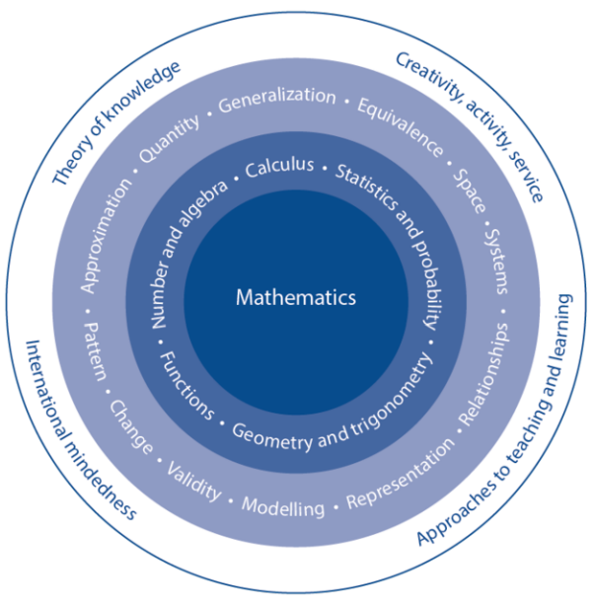
The branches of the MYP framework
Numerical and abstract reasoning
Thinking with models
Reasoning with data
Spatial reasoning
Isabel Dykes & Dimitra Milioni

Slide 9
Prior learning topics (AA/AI )
MYP Mathematics Framework
Statistics and probability
Reasoning with data
The collection of data and its representation in bar charts, pie charts, pictograms, and line graphs
Obtaining simple statistics from discrete data, including mean, median, mode, range
Calculating probabilities of simple events
Venn diagrams for sorting data
Tree diagrams
variability and randomness
causation versus correlation
inferences and informal inferential reasoning
prediction and hypothesis testing
sampling, resampling and aggregation
the role of context in statistical inquiry
the connection between purpose and utility
outliers and how to separate the signal from the noise
critical literacy in statistics, considering sources and evaluating techniques
data distribution and how they can be analysed or compared
the law of large numbers
theoretical and experimental probabilities
listing strategies.
Isabel Dykes & Dimitra Milioni

Slide 10
MYP years 1 to 3 | MYP years 4 and 5
Simple discrete data and classifications Data collection and generation, including surveys Limitations and context in statistical enquiry (reliability of data, bias in sampling and estimation in calculations) Graphical representations, including pie, bar charts, stem and leaf plots, pictograms Data visualizations and infographics Data processing, including mean, median (measure of central tendency) and mode, for discrete and grouped data Measures of dispersion, including range Qualitative handling of probability Probability of simple events Sample spaces Probability scale, including significance of number Theoretical probability and experimental probability
Sampling techniques and response rates
Data manipulation and misinterpretation
Graphical representations, including bivariate graphs/ scatter graphs, box-and-whisker plots, cumulative frequency graphs
Histograms for continuous fixed interval groups
Lines of best fit
Data processing, including mean, median (measure of central tendency) and mode, for continuous data, and quartiles and percentiles for discrete and continuous data
Measures of dispersion, including interquartile range (including application and relationship with the median)
Measures of dispersion, including standard deviation (including application and relationship with the mean)
Describing correlation, including positive, negative, none, strong and weak
Use of technology to find the numerical value for correlation and its meaning
Sets, including notation and operations up to three sets
Probability calculations with Venn Diagrams, tree diagrams and sample space
Probability calculations for dependent and independent events (using the addition and multiplication rules) including conditional probability
Mutually exclusive events
Combined events
Relative frequency

Slide 11
Reasoning with data
Enrichment
Numerical and abstract reasoning
• Manual calculation of standard deviation and correlation coefficient
• Histograms and frequency polygons
• Covariance
• Interpolation and extrapolation
• Confirmation bias
• Counting principles
• Combinatorics
• Permutations
• Factorials
• Geometric mean
• Regression—interpretation of results
• Networks and probability, Pascal’s triangle
Number
• Rationalizing the denominator
• Number bases
Algebra
• Exponential equations
• Use notation and formulae to find the summation of an arithmetic sequence and a geometric sequence
• Sigma notation
• Convergence and divergence
Spatial reasoning
Geometry
• Fractals (informal introduction)
• Dilation
• Inscribing and circumscribing shapes
• Arc length and sector using radians
• Polar coordinates
• Vector notation
• Vector spaces
Trigonometry
• Three-dimensional coordinate geometry
• Area of a triangle rule
• Unit circle
• Radians
• Equation of a circle with centre at the origin
• Trigonometric identities
Thinking with models
• Transforming cubic, and trigonometric functions
• Functions including ln and e
• Composite functions
• Inverse functions
• Logarithmic functions

Slide 12
Assessment objectives
DP Mathematics: Analysis and approaches / Applications and interpretation
Knowledge and understanding | Recall, select and use their knowledge of mathematical facts, concepts and techniques in a variety of familiar and unfamiliar contexts.
Problem solving | Recall, select and use their knowledge of mathematical skills, results and models in both abstract and real-world contexts to solve problems.
Communication and interpretation | Transform common realistic contexts into mathematics; comment on the context; sketch or draw mathematical diagrams, graphs or constructions both on paper and using technology; record methods, solutions and conclusions using standardized notation; use appropriate notation and terminology.
Technology | Use technology accurately, appropriately and efficiently both to explore new ideas and to solve problems.
Reasoning | Construct mathematical arguments through use of precise statements, logical deduction and inference and by the manipulation of mathematical expressions.
Inquiry approaches | Investigate unfamiliar situations, both abstract and from the real world, involving organizing and analyzing information, making conjectures, drawing conclusions, and testing their validity.
Isabel Dykes & Dimitra Milioni

Slide 13
MYP Mathematics Objectives
Knowing and understanding | select appropriate mathematics when solving problems in both familiar and unfamiliar situations apply the selected mathematics successfully when solving problems solve problems correctly in a variety of contexts.
Investigating patterns | select and apply mathematical problem-solving techniques to discover complex patterns describe patterns as general rules consistent with findings prove, or verify and justify, general rules.
Communicating | use appropriate mathematical language (notation, symbols and terminology) in both oral and written explanations use appropriate forms of mathematical representation to present information move between different forms of mathematical representation communicate complete, coherent and concise mathematical lines of reasoning organize information using a logical structure
Applying mathematics in real-life contexts | identify relevant elements of authentic real-life situations select appropriate mathematical strategies when solving authentic real-life situations apply the selected mathematical strategies successfully to reach a solution justify the degree of accuracy of a solution justify whether a solution makes sense in the context of the authentic real-life situation.

Slide 14
Assessment objectives in practice
Assessment objectives | Paper 1 (%) |  | Paper 2 (%) |  | Paper 3 (%) HL only |  | Exploration (%)
 | AA | AI | AA | AI | AA | AI | AA / AI
Knowledge and understanding | 20 - 30 |  | 15 - 25 | 20 - 30 | 10 - 20 |  | 5 - 15
Problem solving | 20 - 30 |  | 15 - 25 | 20 - 30 | 20 - 30 |  | 5 - 20
Communication and interpretation | 20 - 30 |  | 15 - 25 | 20 - 30 | 15 - 25 | 20 - 30 | 15 - 25
Technology | 0 | 20 - 35 | 25 - 35 | 20 - 35 | 10 - 30 |  | 10 - 20
Reasoning | 5 - 15 |  | 5 - 10 | 10 - 20 | 10 - 20 |  | 5 - 25
Inquiry approaches | 10 - 20 | 5 - 15 | 5 - 10 | 5 - 20 | 15 - 30 |  | 25 - 35
MYP Mathematics objectives are equally demonstrated in external on-screen examinations (eAssessment) and are equally weighted for reporting purposes.
Isabel Dykes & Dimitra Milioni

Slide 15
Alignment of objectives
Knowledge and understanding
Knowing and understanding
Problem solving
Investigating patterns
Applying mathematics in real-life contexts
Communication and interpretation
Communicating
Applying mathematics in real-life contexts
Inquiry approaches
Investigating patterns
Applying mathematics in real-life contexts
Isabel Dykes & Dimitra Milioni

Slide 16
Alignment of objectives
Depending upon the school resources, ICT should be used whenever appropriate.
ICT is used as a tool to:
• perform complicated calculations
• solve problems
• draw graphs
• interpret and analyse data
• investigate data and mathematical concepts
• obtain rapid feedback when testing out solutions
• observe patterns and make generalizations
• move between analytical and graphical representations
• visualize geometrical transformations.
Technology
The branches of the MYP mathematics framework are intentionally named to emphasize the need for the development of reasoning habits in students. The command terms, which are incorporated in the objectives / criteria and assessment tasks, engage students with varied levels of thinking/reasoning skills.
Reasoning
Isabel Dykes & Dimitra Milioni

Slide 17
… and exploration criteria
This criterion assesses the organization and coherence of the exploration.
A coherent exploration is logically developed, easy to follow and meets its aim. This refers to the overall structure or framework, including introduction, body, conclusion and how well the different parts link to each other.
A well-organized exploration includes an introduction, describes the aim of the exploration and has a conclusion. Relevant graphs, tables and diagrams should accompany the work in the appropriate place and not be attached as appendices to the document. Appendices should be used to include information on large data sets, additional graphs, diagrams and tables.
A concise exploration does not show irrelevant or unnecessary repetitive calculations, graphs or descriptions
Criterion A: Presentation
Level | Descriptor
4 | The exploration is coherent, well organized, and concise.
Criterion C: Communicating
Level | Descriptor
7-8 | move effectively between different forms of mathematical representation communicate through lines of reasoning that are complete, coherent and concise present work that is consistently organized using a logical structure
Isabel Dykes & Dimitra Milioni

Slide 18
This criterion assesses to what extent the student has:
used appropriate mathematical language (notation, symbols, terminology). Calculator and computer notation is acceptable only if it is software generated. Otherwise it is expected that students use appropriate mathematical notation in their work
defined key terms and variables, where required
used multiple forms of mathematical representation, such as formulae, diagrams, tables, charts, graphs and models, where appropriate
used a deductive method and set out proofs logically where appropriate
Criterion B: Mathematical communication
Level | Descriptor
4 | The mathematical communication is relevant, appropriate and consistent throughout.
Criterion C: Communicating
Level | Descriptor
7-8 | consistently use appropriate mathematical language (notation, symbols and terminology) use appropriate forms of mathematical representation to consistently present information correctly move effectively between different forms of mathematical representation
Isabel Dykes & Dimitra Milioni

Slide 19
Criterion C: Personal engagement
Level | Descriptor
3 | There is evidence of outstanding personal engagement.
This criterion assesses the extent to which the student engages with the topic by exploring the mathematics and making it their own. It is not a measure of effort.
Personal engagement may be recognized in different ways.
These include thinking independently or creatively, presenting mathematical ideas in their own way, exploring the topic from different perspectives, making and testing predictions.
Criterion B: Investigating patterns
Level | Descriptor
7-8 | select and apply mathematical problem-solving techniques to discover complex patterns describe patterns as general rules consistent with correct findings
Criterion D: Applying mathematics in real-life contexts
Level | Descriptor
7-8 | identify the relevant elements of the authentic real-life situation select appropriate mathematical strategies to model the authentic real-life situation
Isabel Dykes & Dimitra Milioni

Slide 20
This criterion assesses how the student reviews, analyses and evaluates the exploration.
Simply describing results represents limited reflection. Further consideration is required to achieve the higher levels.
Some ways of showing meaningful reflection are: linking to the aims of the exploration, commenting on what they have learned, considering some limitation or comparing different mathematical approaches.
Criterion D: Reflection
Level | Descriptor
3 | There is substantial evidence of critical reflection.
Criterion D: Applying mathematics in real-life contexts
Level | Descriptor
7-8 | justify the degree of accuracy of the solution justify whether the solution makes sense in the context of the authentic, real-life situation.
Isabel Dykes & Dimitra Milioni

Slide 21
Criterion E: Use of mathematics
 | Level | Descriptor
SL | 6 | Relevant mathematics commensurate with the level of the course is used. The mathematics explored is correct. Thorough knowledge and understanding are demonstrated.
HL | 6 | Relevant mathematics commensurate with the level of the course is used. The mathematics explored is precise and demonstrates sophistication and rigour. Thorough knowledge and understanding are demonstrated.
Relevant mathematics supports the development of the exploration towards the completion of its aim.
The command term demonstrate means to make clear by reasoning or evidence, illustrating with examples or practical application.
The mathematics can be regarded as correct even if there are occasional minor errors as long as they do not detract from the flow of the mathematics or lead to an unreasonable outcome.
Precise mathematics is error-free and uses an appropriate level of accuracy at all times.
Sophistication in mathematics may include understanding and using challenging mathematical concepts, looking at a problem from different perspectives and seeing underlying structures to link different areas of mathematics.
Rigour involves clarity of logic and language when making mathematical arguments and calculations. Mathematical claims relevant to the development of the exploration must be justified or proven.
Isabel Dykes & Dimitra Milioni

Slide 22
Criterion A: Knowing and understanding
Level | Descriptor
7-8 | select appropriate mathematics when solving challenging problems in both familiar and unfamiliar situations apply the selected mathematics successfully when solving these problems generally solve these problems correctly in a variety of contexts.
Criterion B: Investigating patterns
Level | Descriptor
7-8 | select and apply mathematical problem-solving techniques to discover complex patterns describe patterns as general rules consistent with correct findings prove, or verify and justify, these general rules.
Criterion D: Applying mathematics in real-life contexts
Level | Descriptor
7-8 | apply the selected mathematical strategies to reach a correct solution to the authentic real-life situation justify the degree of accuracy of the solution justify whether the solution makes sense in the context of the authentic, real-life situation.
Criterion C: Communicating
Level | Descriptor
7-8 | communicate through lines of reasoning that are complete, coherent and concise.
Isabel Dykes & Dimitra Milioni

Slide 23
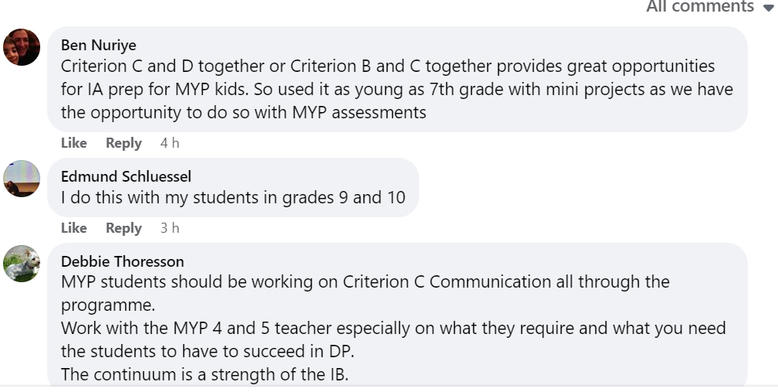
Social media
Isabel Dykes & Dimitra Milioni

Slide 24
IB documentation
The Mathematics: analysis and approaches questions will frequently require the student to discover general patterns, to verify them and to informally justify or prove the result.
The Mathematics: applications and interpretation questions will frequently follow through the solution of a problem in a real-world context using mathematics developed in the course.
In some ways the Mathematics: analysis and approaches questions can be viewed as an extension of Criterion B: Investigating Patterns in the MYP, and the Mathematics: applications and interpretation questions an extension of Criterion D: Applying mathematics in real-life contexts.
Isabel Dykes & Dimitra Milioni

Slide 25
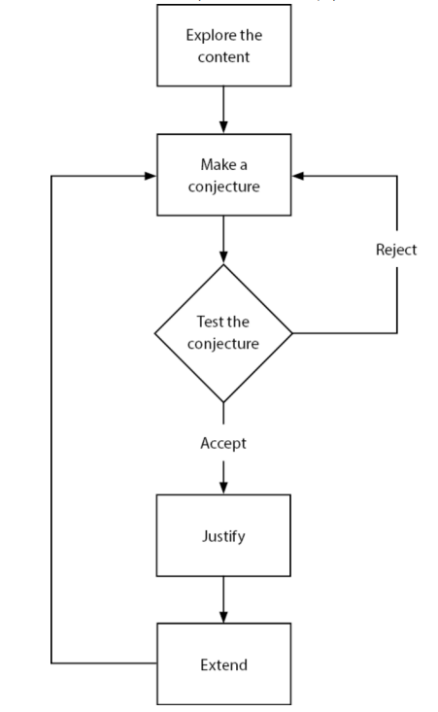
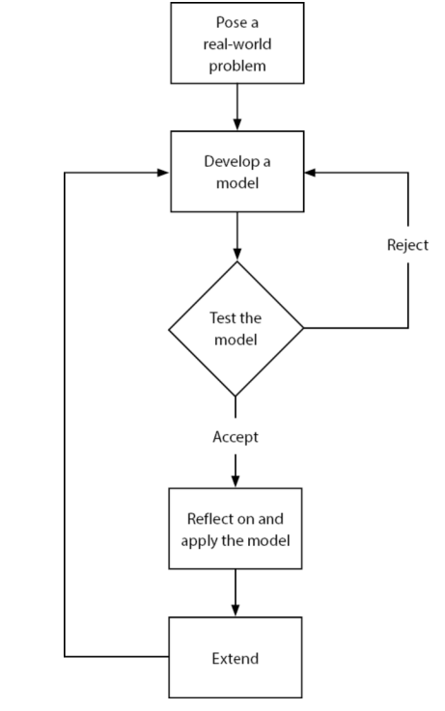
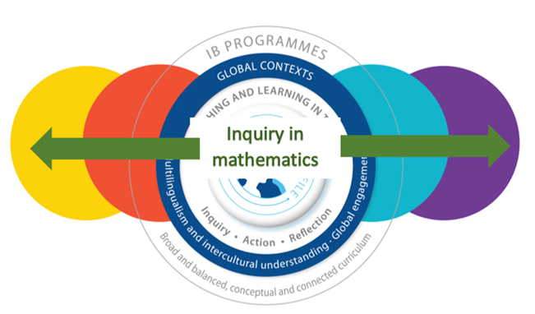
Teaching through inquiry
Isabel Dykes & Dimitra Milioni

Slide 26
and…
Cognitive skills include all the information-processing and thinking skills, often called “study skills” in a school environment.
Affective skills are the skills of behaviour and emotional management underpinning attitudinal factors, such as resilience, perseverance and self-motivation, which often have a large role to play in educational achievement.
Metacognitive skills are the skills that students can use to monitor the effectiveness of their learning skills and processes, to better understand and evaluate their learning.
to be continued…
Isabel Dykes & Dimitra Milioni

Slide 27
References
MYP Mathematics guide. February 2020 (updated November 2022)
MYP: From principles into practice. May 2014 (updated April 2023)
Approaches to learning and approaches to teaching in the Middle Years Programme. September 2022 (updated March 2023)
Mathematics: analysis and approaches guide. February 2019 (updated November 2020)
Mathematics: applications and interpretation guide. February 2019 (updated November 2020)
Mathematics: analysis and approaches/applications and interpretation teacher support material: Preparing for HL paper 3
Approaches to teaching and learning in the Diploma Programme
What is an IB Education. November 2019
Isabel Dykes & Dimitra Milioni

